Slide 1
Đề bài:
Vẽ và format lại các hình ảnh trong slide dựa trên hình ảnh cho trước
Phân tích điểm tư duy trong các slide dựa trên những gì đã học

Slide 2

Executive summary
Multiple forces at work, such as labour scarcity, rising costs of inputs, increased health and safety standards, and declining productivity, have been putting significant pressure on the mining industry in the last decade, e.g.,
Average copper mine input costs have risen ~150% in the past 15 years
In 10 years, productivity in some of the world’s major mining hubs has declined by up to 50%
Mining companies are increasingly looking at technological innovations to address these trends, with a view to reducing costs and increasing productivity
Development, testing and implementation of high-tech solutions in mining have exploded in the past 15 years, with advanced technologies being developed and implemented across all stages of the mining value chain, from exploration to hauling and dozing
There is an increasing sense among all sizes of mining companies that “the future is now”, and that the best-performing companies in the next decades will be the one willing to assume the costs of implementing advanced technologies during this challenging period
Examples of the most promising and most developed advanced technologies include
Autonomous haulage, which has been implemented at ~25 sites and can reduce overall haulage costs 10-40%
Autonomous or tele-remote drilling, which has been trialled at nearly 20 sites, with demonstrated increase of both available drilling time per shift and drilling/blasting accuracy, leading to a knock- on impact on downstream processes
McKinsey & Company | 12

Slide 3



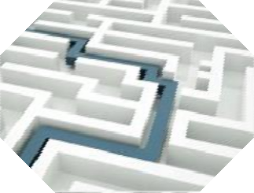
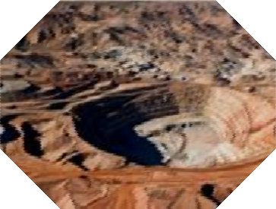


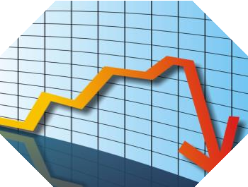

The mining industry faces multiple forces which will adversely impact industry economics going forward
Continuously increasing safety,
health and environment standards
Global sourcing changing equipment industry structure
Rising cost of production inputs
Increasingly challenging geologies
Demand growth fueled by population growth and socio- economic changes
Increasing price volatility
(by-product credits)
Declining productivity
Labor scarcity
These forces will have determine how mines are set up and run in the future
SOURCE: McKinsey Basic Materials Practice
McKinsey & Company | 13

Slide 4

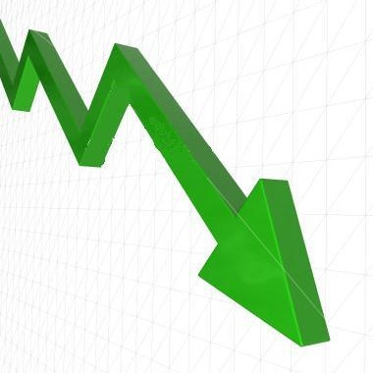
The McKinsey Mining Productivity Index reveals that mining productivity globally has declined 3.5% p.a. over the past decade
McKinsey Mining Productivity
Approach Index, 2004 = 100
McKinsey Mining Productivity Index
110
Between 2004 and 2013, global mining productivity has fallen ~30%, or 3.5% p.a., even after accounting for geological degradation
computed using global data set comprising
Detailed data at mine-site level for ~50 mines from all major mining jurisdictions
10 years of performance data
All values indexed to 2004 = 100
105
100
95
-6.0% p.a.
-3.5% p.a.
90
85
80
-0.4% p.a.
75
70
65
2004 05
06
07
08
09
10
11 12 2013
SOURCE: Company annual reports; McKinsey analysis
McKinsey & Company | 14

Slide 5



Mining companies are increasingly looking at technological innovations to address the declining productivity trends
"Where we're really behind, shamefully behind, is in the issue of productivity"
– Thomas Keller, CEO Codelco; April 2014, CRU World Copper Conference, Santiago
“With our Southdowns project (Western Australia), we are able to vastly improve the economics by steepening the walls and improving the strip ratio because we have proven methods and [remote control drill, rock-breaker and explosives loader] technology to manage those steeper walls”
– Matthew Andersson, Mining Manager, Grange Resources
“Progressive mining companies are beginning to implement automated systems, with the rest of the industry expected to follow suit”
“Autonomous technologies represent a class of innovation that will profoundly change how minerals are mined and processed”
– Ken Stapylton, Vice President surface drilling, Sandvik
“Declining productivity is now a problem we share”
– Paul Dowd, Director OZ
Minerals
“Now we need to protect our operating margins, we have to improve our working practices”,. “The company is moving towards full automation at it’s mines, “something we have been slow to progress in the past”
– Diego Hernandez, CEO Antofagasta
SOURCE: Press search
McKinsey & Company | 15

Slide 6
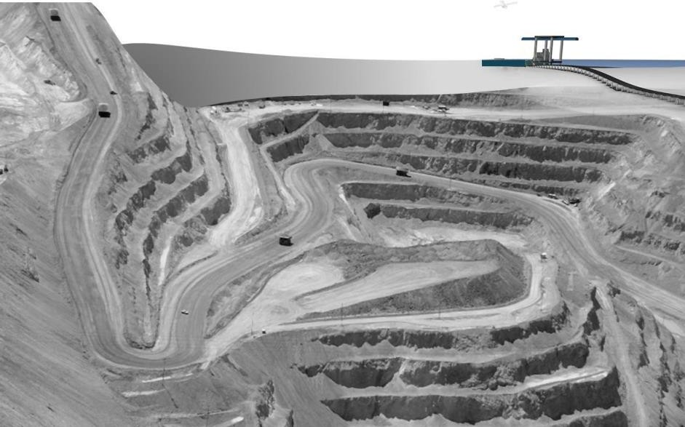

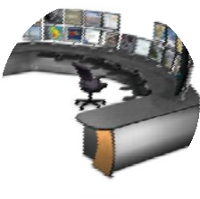










































































Autonomous equipment-enabled open-pit mines rely on the careful and coordinated interplay of the mine-wide control systems and equipment
Control centre
On-site and/or remote. Includes autonomous fleet management software and live monitoring/feedback
Conveyors
Mine LAN and radio communications
Ore tagging
RFID Tag
RFID signal
Loaders
Rock breaker
Drills
Smart equipment
Haul trucks
Dozers
Blast charging
SOURCE: Expert Interviews; Sandvik webpage; Caterpillar webpage; Metso webpage; Transmin webpage
McKinsey & Company | 16

Slide 7
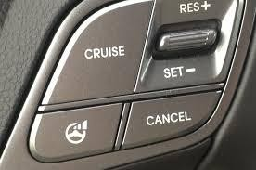
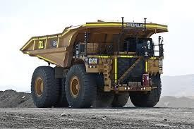




Different degrees of autonomy in haul trucks
Semi-autonomous trucks
Fully autonomous trucks
Driver still present in vehicle
Vehicle has a form of “cruise control” for the length of the haul route
Driver tends to reassume control for loading and dumping, and whenever an obstacle presents itself (e.g., manned vehicle, obstruction in the road)
All stages of haul cycle are autonomous
No operator is required in vehicle
One operator can oversee multiple
trucks simultaneously from a remote control centre
Command centre can be on- or off- site
There are currently 3 archetypes of fully
autonomous trucks (detailed next page)
SOURCE: Expert interviews
McKinsey & Company | 17

Slide 8
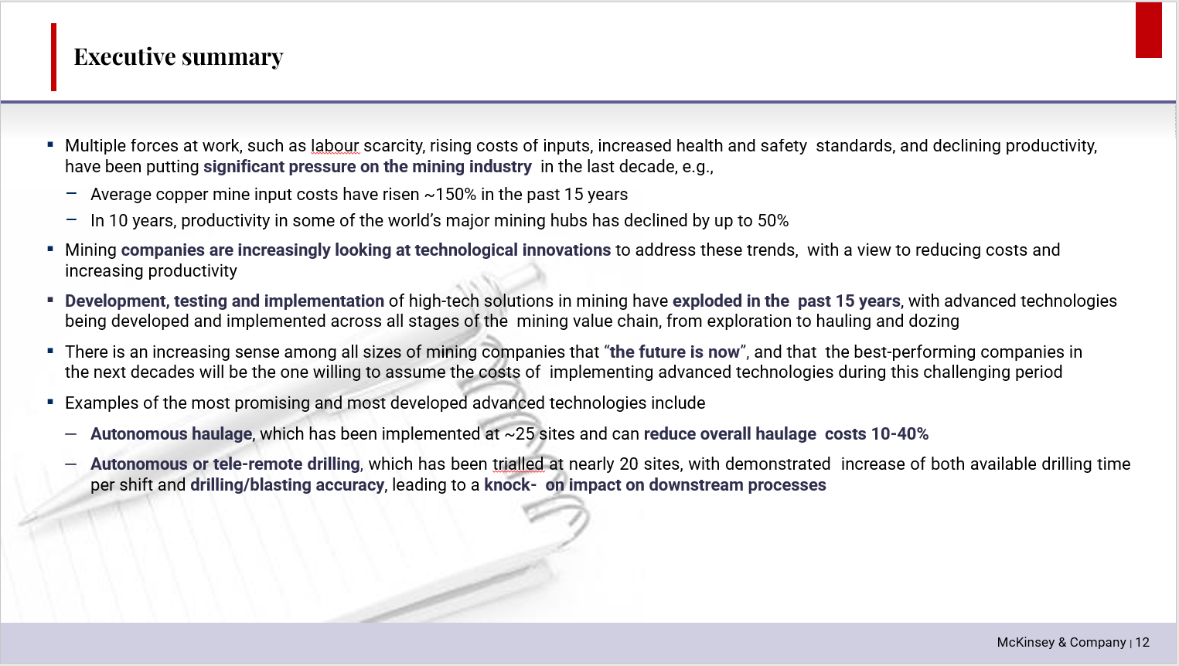
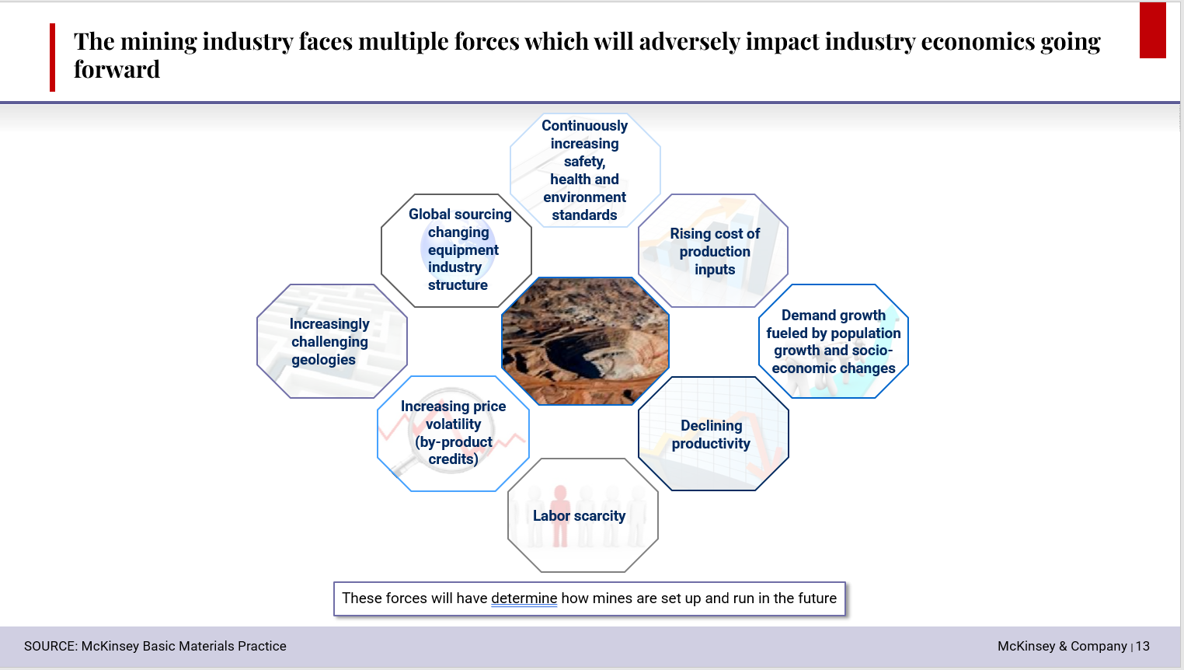
Phân tích điểm tư duy trong các slide dựa trên những gì đã học
4
3
2
A
1
B
A
Nội dung ghi dưới dạng bullet point giúp dễ dàng theo dõi.
1
Hình ảnh infographic chìm tăng tính thẩm mỹ.
B
Nội dung text có phần highlight giúp dễ dàng nắm rõ trọng tâm.
2
Highlight giúp làm nổi bật nội dung.
3
Nội dung chính của slide được thể hiện bằng hình ảnh và đặt tại trung tâm.
4
Nội dung được đặt trong shape bát giác và sắp xếp vây quanh hình ảnh làm mang tính bố cục thu hút người xem.

Slide 9
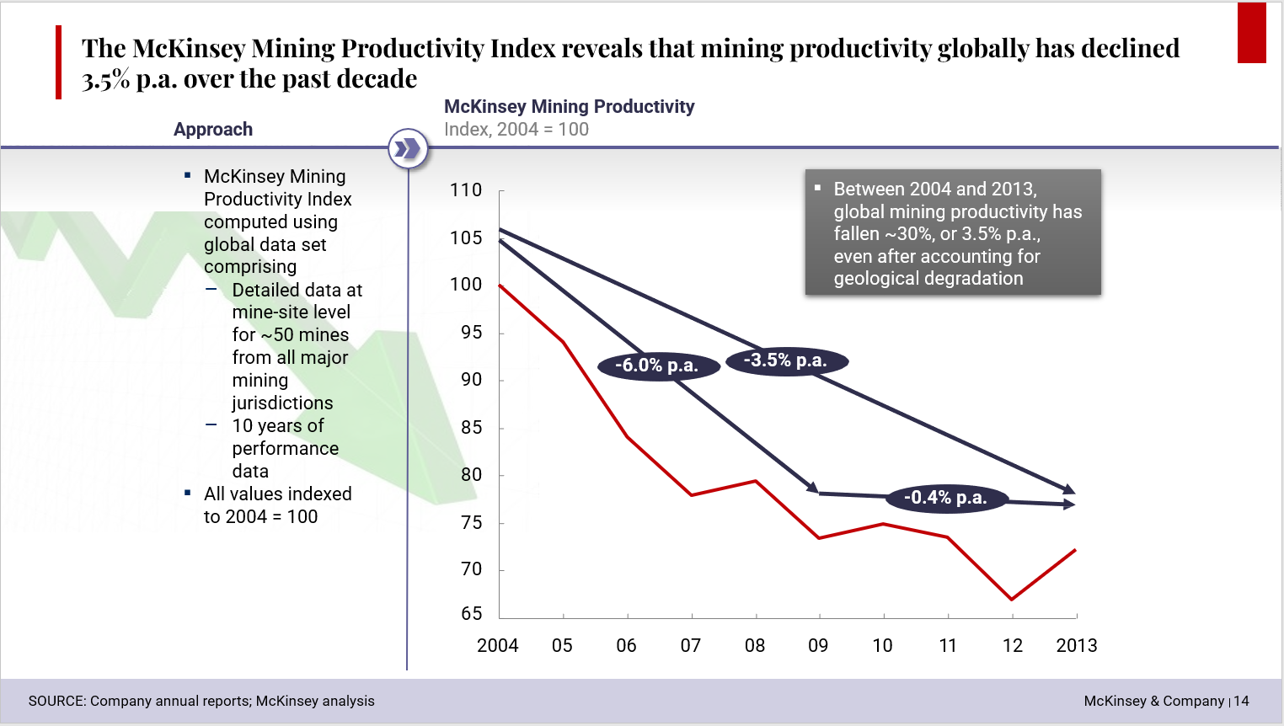
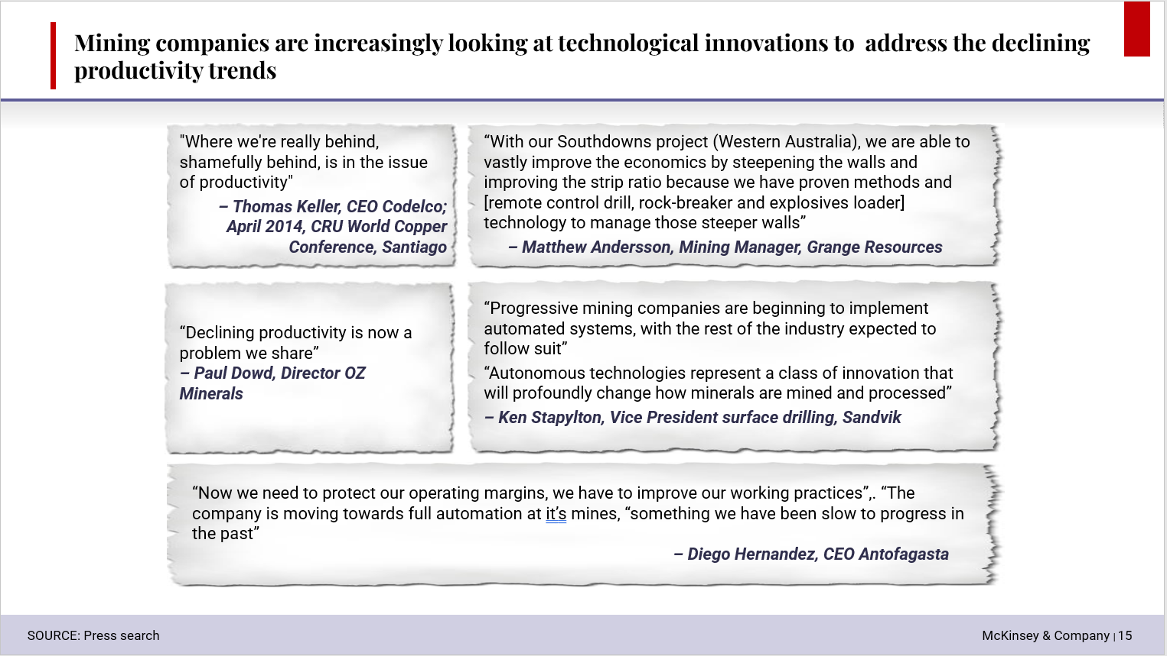
Phân tích điểm tư duy trong các slide dựa trên những gì đã học
C
4
B
3
2
A
1
D
A
Nội dung ghi dưới dạng bullet point giúp dễ dàng theo dõi.
1
Dẫn chứng và tác giả được phân biệt rõ ràng bằng cách in đậm và thay đổi màu sắc của nó.
B
2
Thay vì đưa ra dẫn chứng bằng những box hình chữ nhật thông thường thì được thay thế bằng các box có chất liệu bằng giấy để tang tính thẩm mỹ hơn.
Hình ảnh infographic chìm tăng tính thẩm mỹ.
C
Nội dung text và đồ thị được ngăn cách rõ ràng giúp người xem tập trung vào từng phần hơn cũng như dễ nhìn hơn.
3
Bố cục nội dung được sắp xếp theo dạng lưới (grid) làm tăng tính thẩm mỹ hơn so với cách sắp xếp thông thường.
D
Trình bày thông tin rõ ràng trên trục hoành cũng như trục tung đồng thời xóa bớt những yếu tố gây nhiễu chỉ nhấn mạnh những điểm cần lưu ý trên đồ thị.
4
Có đường ngăn cách giữa header và body đồng thời có sử dụng đổ bóng tạo cảm giác header được sắp xếp dạng 3D cũng như cô lập tiêu đề và phần than rõ rệt.

Slide 10
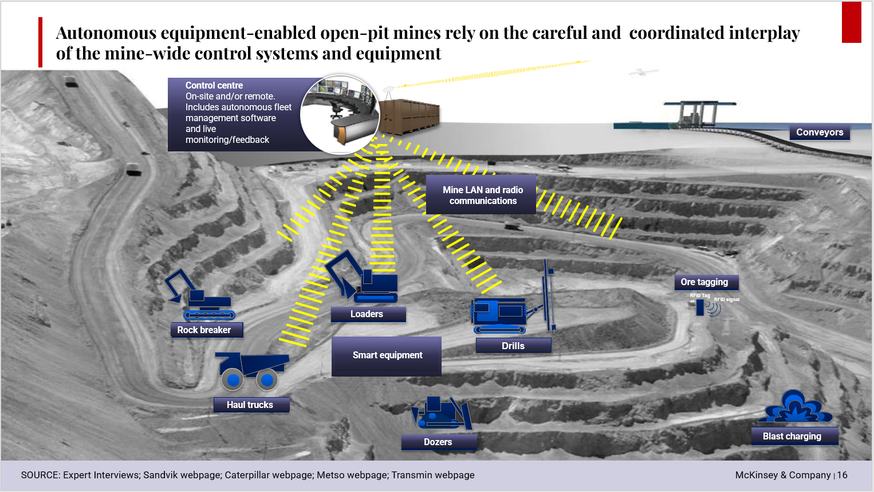
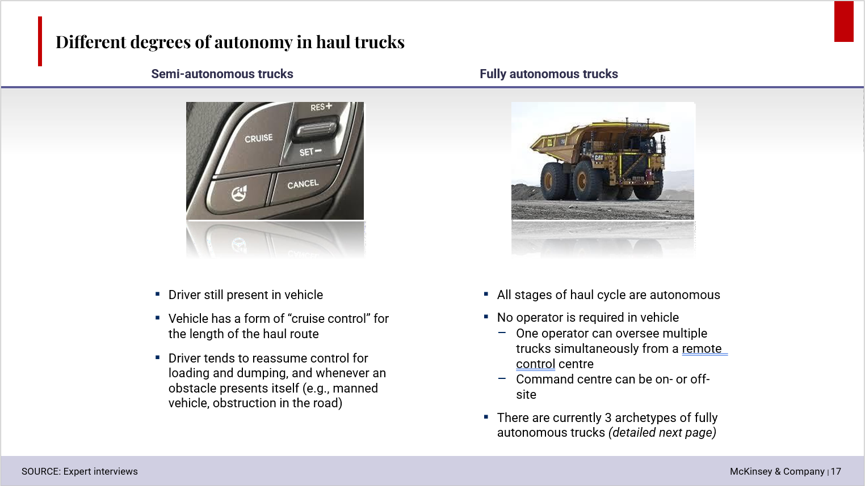
Phân tích điểm tư duy trong các slide dựa trên những gì đã học
B
4
3
A
1
2
C
A
Các hình ảnh thiết bị được sắp xếp một cách logic giúp người xem biết được đâu là thiết bị gì và vị trí của nó.
1
Bố cục rõ ràng khi hình ảnh và text được sắp xếp tại 2 khu vực riêng biệt.
B
Chú thích các thiết bị được đặt gọn trong box làm nổi bật hơn so với nội dung không chứa trong box khi đặt trên background chìm như trong ví dụ .
2
Nội dung ghi dưới dạng bullet point giúp dễ dàng theo dõi.
C
Footer có màu sắc riêng giúp người xem dễ dàng phân biệt được đâu là phần header đâu là body và footer.
3
Hình ảnh kết hợp với Shape effects giúp mang tính thẩm mỹ hơn cũng như cô lập hình ảnh và text rõ rệt hơn.
4
Có đường ngăn cách giữa header và body đồng thời có sử dụng đổ bóng tạo cảm giác header được sắp xếp dạng 3D cũng như cô lập tiêu đề và phần than rõ rệt.

